Slide 1
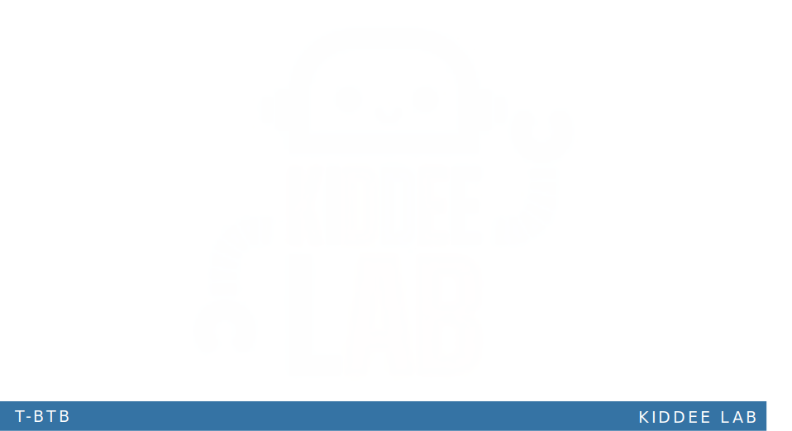

Support Vector Machine (SVM)

Slide 2

Support Vector Machine (SVM)
SVMs find a hyperplane to separate data into different classes.
The hyperplane is chosen to maximize the margin between classes.
Margin is the distance between the hyperplane and the nearest data points from each class.
SVMs use a kernel function to transform input data into a higher-dimensional space.
In this higher-dimensional space, it's easier to find a linear boundary between classes.

Slide 3
SVM vs Classication
Support Vector Machine (SVM)
Draws the best line (or boundary) between different groups of points to separate them with the widest possible gap.
Focuses on finding the line farthest from the closest points of each group, called support vectors.
Classification:
Sorts data into categories or classes.
Involves predicting the category of new data based on past observations.
SVM is one of many methods used for classification.
Notes:
Machine Learning บทที่ 8: Support Vector Machines (guopai.github.io)

Slide 4
Chatbot with SVM
SVMs can handle non-linear data using kernel functions.
Kernel functions map data into a higher-dimensional space for easier linear separation.
This ability is beneficial for dealing with complex conversations with multiple intents and entities.
SVMs can handle imbalanced data by adjusting class weights.
Adjusting weights gives more importance to minority classes, addressing imbalanced datasets common in chatbot development
Notes:
“Understanding the Inner Workings of SVM: From Data Preprocessing to Model Deployment” | by Vinayak Deshpande | Medium

